Slide 1
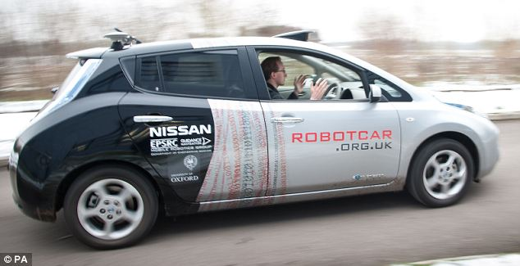
Improving Video Activity Recognition using Markov Logic Networks
Improving Video Activity Recognition
using Markov Logic Networks
Process
Confidence from Video Features
Input : A Video Clip
Extract HoG/HoF features for all the clips
Convert each clip into histogram over Video features
Learn a SVM model to predict confidence information over video features
Run object detector over frames to get confidence information over object features
Feed the information to MLN model
Input : Training & Testing Video Clips
Output : Activity predictions from SVM
Extract HoG/HoF features for all the clips
Run k-means to find the clusters
Convert each clip into the histogram
This is the bag-of-features representation.
Train a SVM model
MLN
Enhanced
MLN rules (FOL)
Weight Learning
Confidence information
using Object and Video
Features
References
Confidence from Object Features
Predictions
Laptev et.al. Actions in context , CVPR, 2009
Parag Singla et. al. Markov Logic, PILP, Springer, 2008
Input : Training & Testing Video Clips
Output : Object predictions
Break each clip into frames.
Run Object detector over frames
Process the output of object detector to get confidence
MLN Model ( Rules and weights )
Better
Prediction

